Slide 1
chmod
There are three types of permissions: read (r), write (w), and execute (x).
To read a file is to view its contents. For example, a text file must have read permission for someone to read the text within.
If the user wants to add a sentence to that file, it needs write permission.
The execute permission enables someone to run a file, such as a shell script or a binary program file
The ls -l command displays the permissions assigned to a file.

Slide 2

user, group, and other.
Each file is associated with an owner and a group and assigned with permission access rights for three different classes of users:
The file owner.
The group members.
Others (everybody else)

Slide 3
operation
- Removes the specified permissions.
+ Adds specified permissions.
= Changes the current permissions to the specified permissions. If no permissions are specified after the = symbol, all permissions from the specified user class are removed.

Slide 4
Directories are special types of files that contain other files and directories.
Permission | Character | Meaning on Directory
Read | - | The directory’s contents cannot be shown.
 | r | The directory’s contents can be shown. (e.g. You can list files inside the directory with ls.)
Write | - | The directory’s contents cannot be altered.
 | w | The directory’s contents can be altered. (e.g. You can create new file ,delete file..etc.)
Execute | - | The directory cannot be changed to.
 | x | The directory can be navigated using cd.

Slide 5
The chmod command allows you to change the permissions on a file using either a symbolic or numeric mode or a reference file.
Symbolic (Text) Method
chmod [OPTIONS] [ugoa…][-+=]perm s FILE
The permissions (perms...) can be explicitly set using either zero or one or more of the following letters: r, w, x . Use a single letter from the set u, g, and o when copying permissions from one to another users class.

Slide 6
Numeric Method
The syntax of the chmod command when using numeric method has the following format
chmod [OPTIONS] NUMBER FILE...
When using the numeric mode, you can set the permissions for all three user classes (owner, group, and all others) at the same time.
the first digit represents the permissions of the file’s owner, the second one the file’s group, and the last one all other users.

Slide 7
Each write, read, and execute permissions have the following number value:
r (read) = 4 1
w (write) = 2 1
x (execute) = 1 4 and 2
no permissions = 0
The permissions number of a specific user class is represented by the sum of the values of the permissions for that group.

Slide 8
calculate the totals for all users classes. For example, to give read, write and execute permission to the file’s owner, read and execute permissions to the file’s group and only read permissions to all other users you would do the following:
Owner: rwx=4+2+1=7
Group: r-x=4+0+1=5
Others: r-x=4+0+0=4
Using the method above we come up to the number 754, which represents the desired permissions.

Slide 9
ping
The ping command lets you verify that you have network connectivity with another network device. It is commonly used to help troubleshoot networking issues. To use ping, provide the IP address or machine name of the other device.

Slide 10
ps
The ps command lists running processes. Using ps without any options causes it to list the processes running in the current shell.

Slide 11
tty
tty is a command in Unix and Unix-like operating systems to print the file name of the terminal connected to standard input. tty stands for TeleTYpewriter.
the tty command basically prints the file name of the terminal connected to standard input.

Slide 12
kill
To terminate a process use “kill”
Kill pid
Rules are simple:
You can kill all your own process.
Only root user can kill system level process.
Only root user can kill process started by other users.
used to terminate processes manually. kill command sends a signal to a process which terminates the process. If the user doesn’t specify any signal which is to be sent along with kill command then default TERM signal is sent that terminates the process.

Slide 13
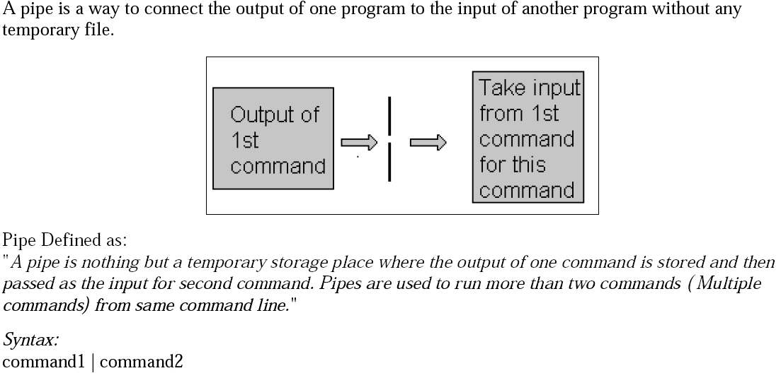
PIPES

Slide 14
A pipe is a form of redirection (transfer of standard output to some other destination) that is used in Linux and other Unix-like operating systems to send the output of one command/program/process to another command/program/process for further processing.
You can make it do so by using the pipe character ‘|’.
It can also be visualized as a temporary connection between two or more commands/ programs/ processes.
Pipes are unidirectional i.e data flows from left to right through the pipeline.
The pipe acts as a container which takes the output of ls -l and gives it to more as input. This command does not use a disk to connect standard output of ls -l to the standard input of more because pipe is implemented in the main memory.

Slide 15
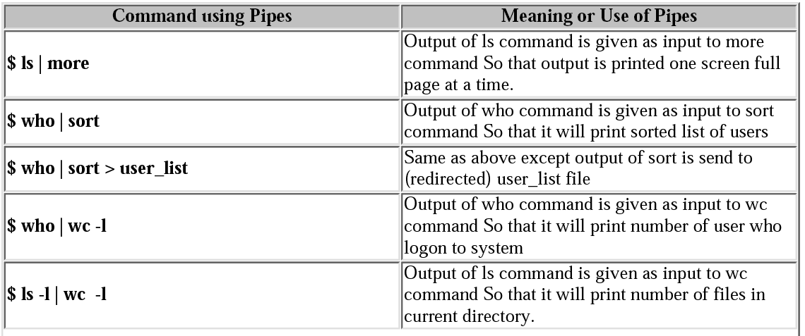
PIPE(Examples)

Slide 16
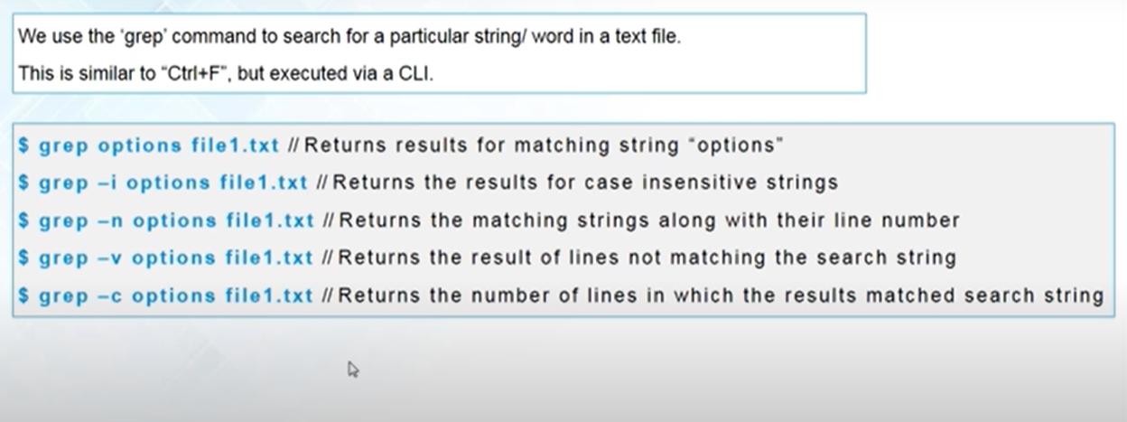
Grep Command
grep searches the named input FILEs for lines containing a match to the given PATTERN.

